Slide 1
Java String

Slide 2
Java String
String represents group of “characters”.
In C/C++ languages, a string represents an array of characters, where the last character will be ‘\0’(null character).
Example: In C/C++,”JAVA” is internally represented by
But this is not valid in java.
String is not a character array. In java, we have both “character array” as well as “String”.
String is immutable: Immutable simply means unmodifiable or unchangeable. Once string object is created its data or state can't be changed but a new string object is created.
Note: String objects are stored in a special memory area known as string constant pool.
J | A | V | A | \0

Slide 3



Creating Strings
1. We can create a String by assigning a group of characters to a String type variable.
Each time we create a string literal, the JVM checks the string constant pool first. If the string already exists in the pool, a reference to the pooled instance is returned. If string doesn't exist in the pool, a new string instance is created and placed in the pool.

Slide 4

Creating Strings
2. We can create an object String class by using new operator.
Ex: String s=new String(“hello"); //creates two objects and one reference variable
In such case, JVM will create a new string object in normal(non pool) heap memory and the literal "Welcome" will be placed in the string constant pool. The variable s will refer to the object in heap(non pool).

Slide 5


Java Strings
3. We can create String by converting ‘char’ array into Strings.
4. We can create String by converting ‘byte’ array into Strings.
Notes:
Note: Garbage collector is not allowed to access SCP area, all SCP objects will be destroyed automatically at the time of JVM shutdown

Slide 6
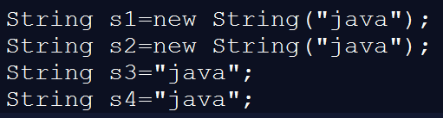
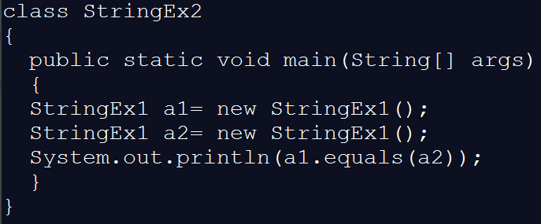
Question?
How many objects will be created?
What is the output of the code given below?
Notes:
Output1: 3
Output2: false

Slide 7
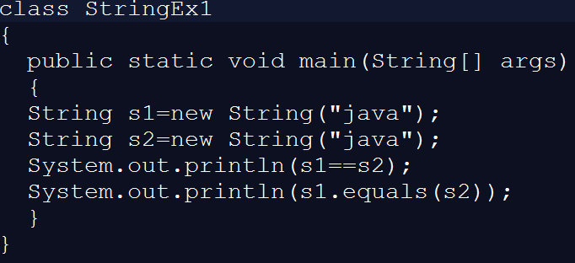
Question?
What is the output of the code given below?
What is the difference between the statements given below?
String s=“”;
String s= null;
String s;
Notes:
Output-1: false
true
Output2: false
In String class, equals method is overridden which is meant for content comparison

Slide 8

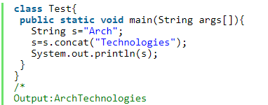
Important methods of String class
char charAt(int index) Returns the char value at the specified index
String concat(String str) Concatenates the specified String to the end of this String

Slide 9
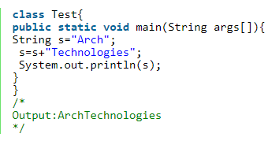
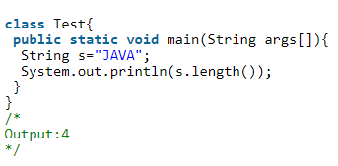
Important methods of String class
Note: The same concatenation can be done by using ‘+’ operator which is called “String Concatenation operator”
3. int length()
Returns the length of a given String

Slide 10
Important methods of String class
4. Java String compare
We can compare string in java on the basis of content and reference.
It is used in authentication (by equals() method), sorting (by compareTo() method), reference matching (by == operator) etc.
There are three ways to compare string in java:
By equals() method
By = = operator
By compareTo() method

Slide 11
Important methods of String class
String compare by equals() method
The String equals() method compares the original content of the string. It compares values of string for equality. String class provides two methods:
public boolean equals(Object another) compares this string to the specified object.
public boolean equalsIgnoreCase(String another) compares this String to another string, ignoring case.

Slide 12
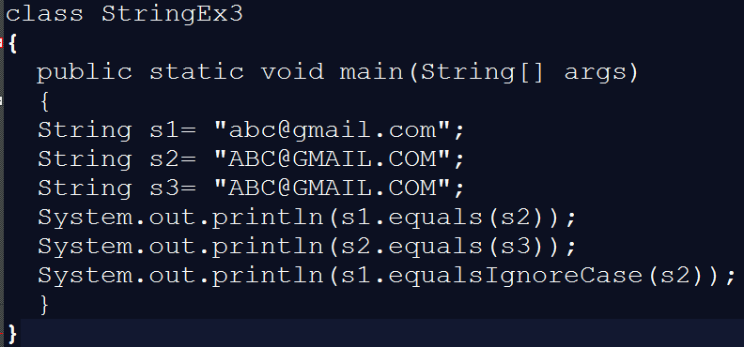
Important methods of String class

Slide 13
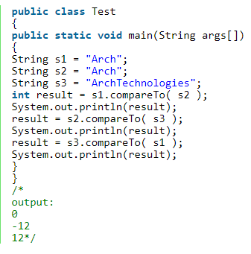
Important methods of String class
String compare by comareTo() method: This is method is useful to compare two strings and to know which string is bigger or smaller.

Slide 14
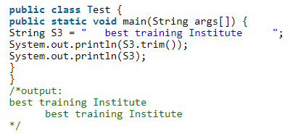
Important methods of String class
5. String trim() This method removes the spaces present at beginning and ending of the String but not middle blank spaces.

Slide 15
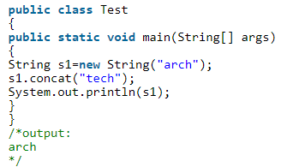
Immutability of Strings
We can divide objects broadly as mutable and immutable objects.
mutable object: mutable objects are those objects whose contents can be modified.
immutable Object: immutable objects are those objects, once created can not be modified and String class objects are immutable objects.

Slide 16
StringBuffer & StringBuilder
StringBuffer
If the content is going to change frequently then it is not recommended to use String because for every modification a new String object will be created.
We can handle this type of requirement by using StringBuffer.If we are performing any modification. It will take place in the existing object only instead of creating new object

Slide 17
Difference between StringBuffer and StringBuilder
No. | StringBuffer | StringBuilder
1) | StringBuffer is synchronized i.e. thread safe. It means two threads can't call the methods of StringBuffer simultaneously. | StringBuilder is non-synchronized i.e. not thread safe. It means two threads can call the methods of StringBuilder simultaneously.
2) | StringBuffer is less efficient than StringBuilder. | StringBuilder is more efficient than StringBuffe

